Slide 1

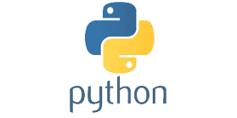
PYTHON
Lecture 39

Slide 2

Today’s Agenda
Introduction To Object Oriented Programming-I
Problems With Procedure Oriented Programming
What Is Object Oriented Programming ?
What Is A Class ?
What Is An Object ?
Syntax Of Creating A Class In Python
Syntax Of Creating Object
Types Of Data Members A Class Can Have
The Method __init__()
The Argument self
Passing Parameters To __init__()

Slide 3
Question ???
Can you tell , what kind of programming paradigm we have followed this point in Python ?
The answer is : POP (Procedure Oriented Programming)
In all the programs we wrote till now, we have designed our program around functions i.e. blocks of statements which manipulate data.
This is called the procedure-oriented programming.

Slide 4
Advantages
Advantages Of Procedure Oriented Programming
It’s easy to implement
The ability to re-use the same code at different places in the program without copying it.
An easier way to keep track of program flow for small codes
Needs only less memory.

Slide 5
Disadvantages
Disadvantages Of Procedure Oriented Programming
Very difficult to relate with real world objects.
Data is exposed to whole program, so no security for data.
Difficult to create new data types
Importance is given to the operation on data rather than the data.

Slide 6
So , What Is The Solution ?
Solution to all the previous 4 problems is Object Oriented Programming
Many people consider OOP to be a modern programming paradigm, but the roots go back to 1960s.
The first programming language to use objects was Simula 67

Slide 7
What Is OOP?
OOP is a programming paradigm (way of developing programs)
OOP allows us to combine the data and functionality and wrap it inside something which is called an object

Slide 8
What Is An Object?
In programming any real world entity which has specific attributes or features can be represented as an Object.
Along with attributes each object can take some actions also which are called it’s “behaviors”
In programming world, these attributes are called data members and behaviours/actions are called methods

Slide 9
Are We Objects ?
Yes , we humans are objects because:
We have attributes as name, height, age etc.
We also can show behaviors like walking, talking, running, eating etc

Slide 10
Classes
Now to create/represent objects we first have to write all their attributes and behaviours under a single group .
This group is called a class

Slide 11
Classes
A class is used to specify the basic structure of an object and it combines attributes and methods to be used by an object
Thus we can say that a class represents the data type and object represents a kind of variable of that data type
For Example:- Each person collectively come under a class called Human Being. So we belong to the class Human Being.

Slide 12
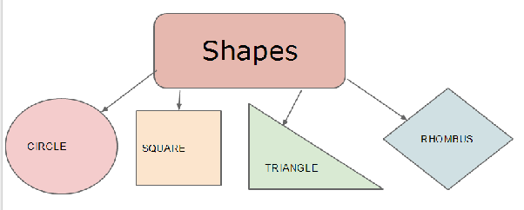
Objects and Classes

Slide 13

Objects and Classes

Slide 14
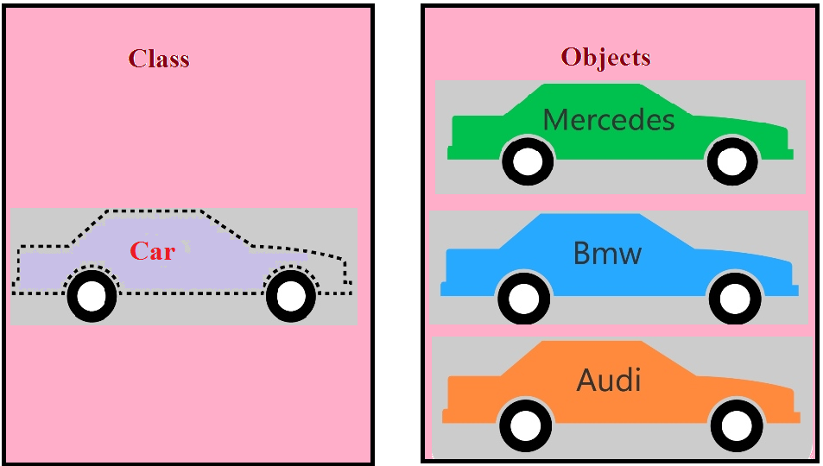
Objects and Classes

Slide 15
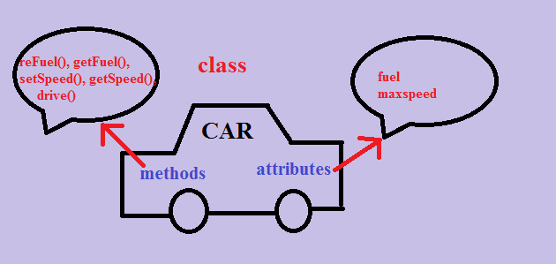
Objects and Classes

Slide 16
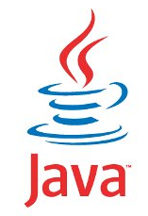
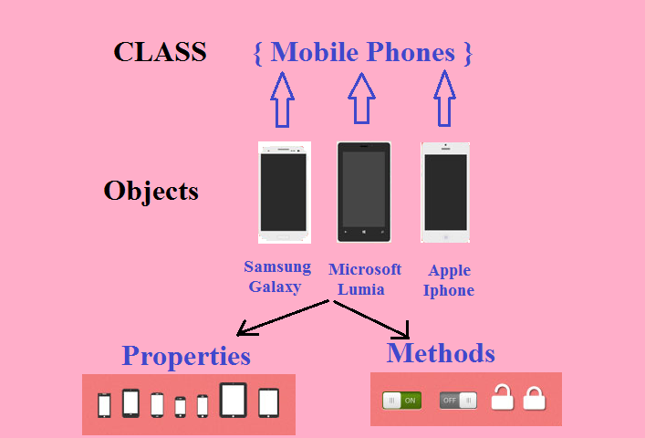
Objects and Classes

Slide 17
Creating A Class
Defining a class is simple in Python.
We start with the class keyword to indicate that we are creating a class, then we add the name of the class followed by a colon
We can then add class members , which are methods and attributes

Slide 18
Syntax Of Creating A Class
Syntax:
class <class_name>:
# class members
Example:
class Emp:
pass

Slide 19
Creating Objects
In order to use a class we have to create it’s object which is also called instantiating a class because objects are also called instance of the class
So, to create an instance of a class, we use the class name, followed by parentheses and assign it to a variable.

Slide 20
Syntax Of Creating Object
Syntax:
var_name=class_name( )
Example:
e=Emp()

Slide 21
Full Code
class Emp:
pass
e=Emp()
print(type(e))
print(e)
Output:
1.The first line shows the class name which is Emp.
2. The second line shows the address of the object to which the reference e is pointing
3. The name __main__ is the name of the module which Python automatically allots to our file

Slide 22
Adding Data Members/Attributes
Once we have defined the class , our next step is to provide it data members/variables which can be used to hold values related to objects.
In Python , a class can have 3 types of variables:
Instance Variables: Created per instance basis
Local Variables: Created locally inside a method and destroyed when the method execution is over
Class Variables: Created inside a class and shared by every object of that class. Sometimes also called as static variables

Slide 23
What Is An Instance Variable?
Object variables or Instance Variables are created by Python for each individual object of the class.
In this case, each object has its own copy of the instance variable and they are not shared or related in any way to the field by the same name in a different object

Slide 24
Creating Instance Variables
Creation of instance variables in Python is entirely different than C++ or Java
In these languages , we declare the data members inside the class and when we instantiate the class , these members are allocated space .

Slide 25
Creating Instance Variables In C++
For example in C++ ,we would write :
class Emp
{
int age;
char name[20];
double salary;
……..
……..
}
Now to use this Emp class we would say:
Emp e;
Doing this will create an object in memory by
the name e and will contain three
instance members called as
age , name and salary . Also this line
will automatically call a special method
called constructor for
initializing the object
These are called instance variables in C++

Slide 26
Creating Instance Variables In Java
In Java ,we would write :
class Emp
{
int age;
String name;
double salary;
……..
……..
}
Now to use this Emp class we would say:
Emp e=new Emp( )
Doing this will create an object in heap with
the data members as age , name and salary
and the reference e will be pointing to that
object. Here also the special method
called constructor will be called
automatically for initializing the object
These are called instance variables in Java

Slide 27
Creating Instance Variables In Python
But in Python we use a very special method called __init__() , to create as well as initialize an object’s initial attributes by giving them their default value.
Python calls this method automatically , as soon as the object of the class gets created.
Since it is called automatically , we can say it is like a constructor in C++ or Java.

Slide 28
Full Code
class Emp:
def __init__(self):
print("Object created. . .")
e=Emp()
Output:
As you can observe , Python has automatically called the special method __init__() as soon as we have created the object of Emp class

Slide 29

Another Example
class Emp:
def __init__(self):
print("Object created. . .")
e=Emp()
f=Emp()
g=Emp()
Output:

Slide 30
The argument self ?
You must have noticed that the code is using an argument called self in the argument list of __init__()
So , now 2 questions arise , which are :
What is self ?
Why it is required ?

Slide 31
What Is self ?
In Python , whenever we create an object , Python calls the method __init()__
But while calling this method , Python also passes the address of the object , for which it is calling __init__() , as the first argument.
Thus , when we define the __init__() method we must provide it atleast one formal argument which will receive the object’s address .
This argument is named as self

Slide 32
What If We Don’t Create self ?
class Emp:
def __init__():
print("Object created. . .")
e=Emp()
Output:
As you can observe , Python has generated an exception , since it has passed the object address as argument while calling the method __init__() but we have not declared any argument to receive it

Slide 33
Can We Give Some Other Name To self ?
class Emp:
def __init__(myself):
print("Object created. . .")
e=Emp()
Output:
As you can observe , Python has allowed us to use the name myself instead of self , but the convention is to always use the word self

Slide 34
More About self
Python always passes address of the object to every instance method of our class whenever we call it, not only to the method __init__()
So, every instance method which we define in our class has to compulsorily have atleast one argument of type self

Slide 35
More About self
The argument self always points to the address of the current object
We can think it to be like this reference or this pointer of Java or C++ languages

Slide 36
Is self A Keyword ?
No , not at all
Many programmers wrongly think self to be a keyword but it is not so.
It is just a name and can be changed to anything else but the convention is to always use the name self
Another Important Point!
The argument self is local to the method body , so we cannot use it outside the method

Slide 37
Guess The Output
class Emp:
def __init__(self):
print("Object Created...")
e=Emp()
print(self)
Output:

Slide 38
The Most Important Role Of self
We can also use self to dynamically add instance members to the current object.
To do this ,we simply have to use self followed by dot operator followed by name of the variable along with it’s initial value
Syntax:
class <class_name>:
def __init__(self):
self.<var_name>=value
.
.

Slide 39
Example
The variables self.age,self.name and self.salary are called instance variables
class Emp:
def __init__(self):
self.age=25
self.name="Rahul"
self.salary=30000.0
e=Emp()
print("Age:",e.age,"Name:",e.name,"Salary:",e.salary)
Output:
Remember , we cannot use self outside the class . So outside the class we will have to use the reference variable e
Another very important point to understand if you are from C++ background is that in Python by default everything in a class is public . So we can direclty access it outside the class

Slide 40
A Very Important Point!
The instance variables called age , name and salary are accessed in 2 ways in Python:
Inside the methods of the class , they are always accessed using self so that Python will refer them for current object
Outside the class , we cannot access them using self because self is only available within the class.
So outside the class we have to access them using the object reference we have created

Slide 41
Guess The Output ?
class Emp:
def __init__(self):
self.age=25
self.name="Rahul"
e=Emp()
e.salary=30000.0
print("Age:",e.age,"Name:",e.name,"Salary:",e.salary)
Output:
Unlike C++ or Java , in Python we can create instance variables outside the class by directly using the object reference

Slide 42
A Problem With The Code
Although the code works fine , but it has one problem .
The problem is that for every object of Emp class , Python will call __init__() method and thus every object will be initialized with the same values
To overcome this problem we can make the method __init__() parameterized

Slide 43
Passing Parameters To __init__()
Since __init__() is also a method so just like other methods we can pass arguments to it .
But we need to remember 2 things for this:
Since __init__() is called by Python at the time of object creation so we will have to pass these arguments at the time of creation of the object
We will have to define parameters also while defining __init__() to receive these arguments
Finally using these parameters we can initialize instance members to different values for different objects

Slide 44
Passing Parameters To __init__()
class Emp:
def __init__(self,age,name,salary):
self.age=age
self.name=name
self.salary=salary
e=Emp(25,"Rahul",30000.0)
print("Age:",e.age,"Name:",e.name,"Salary:",e.salary)
f=Emp(31,"Varun",45000.0)
print("Age:",f.age,"Name:",f.name,"Salary:",f.salary)
Output:
The variables age, name an salary are called local variables

Slide 45
An Important Point
The argument self , should always be the first argument as Python passes the address of the current object as the first argument
The variables age , name and salary used in the argument list of __init__() are called parameters or local variables.
They will only survive until the method is under execution and after that they will be destroyed by Python

Slide 46
An Important Point
Any variable declared inside the body of any method inside the class without using self will also be called as local variable
It is a common convention to give parameters the same name as instance members , but it is not at all compulsory.

Slide 47
Passing Parameters To __init__()
class Emp:
def __init__(self,x,y,z):
self.age=x
self.name=y
self.salary=z
e=Emp(25,"Rahul",30000.0)
print("Age:",e.age,"Name:",e.name,"Salary:",e.salary)
f=Emp(31,"Varun",45000.0)
print("Age:",f.age,"Name:",f.name,"Salary:",f.salary)
Output:

Slide 48
Guess The Output ?
class Emp:
def __init__(self,name):
self.name=name
def __init__(self,name,age):
self.name=name
self.age=age
def __init__(self,name,age,sal):
self.name=name
self.age=age
self.sal=sal
Output:
e1=Emp("amit")
e2=Emp("sumit",23)
e3=Emp("deepak",34,50000.)
print(e1.name)
print(e2.name,e2.age)
print(e3.name,e3.age,e3.sal)

Slide 49
Why Didn’t The Code Run ?
Recall , that we have already discussed that PYTHON DOES NOT SUPPORT METHOD/FUNCTION OVERLOADING .
So if two methods have same name then the second copy of the method will overwrite the first copy.
So , in our case Python remembers only one __init__() method , which is defined last and since it is taking 3 arguments (excluding self) so our call:
e1=Emp(“amit”)
generated the exception

Slide 50
Question ?
Can we do something so that the code runs with different number of arguments passed to Emp objects ?
Yes !
The solution is to use default arguments

Slide 51

Solution
class Emp:
def __init__(self,name,age=0,sal=0.0):
self.name=name
self.age=age
self.sal=sal
e1=Emp("amit")
e2=Emp("sumit",23)
e3=Emp("deepak",34,50000.)
print(e1.name)
print(e2.name,e2.age)
print(e3.name,e3.age,e3.sal)
Output:

